Slide 1
Concurrency Bugs

Slide 2
Bugs in concurrent programs
Writing multi-threaded programs is tricky
Bugs are non-deterministic and occur based on execution order of threads – very hard to debug
Two types of bugs
  Deadlocks: threads cannot execute any further and wait for each other
  Non-deadlock bugs: non deadlock but incorrect results when threads execute

Slide 3
Non deadlock bugs
Atomicity bugs – atomicity assumptions made by programmer are violated during execution of concurrent threads
  Fix: locks for mutual exclusion
Order-violation bugs – desired order of memory accesses is flipped during concurrent execution
  Fix: condition variables

Slide 4
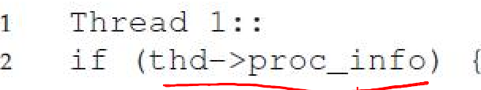
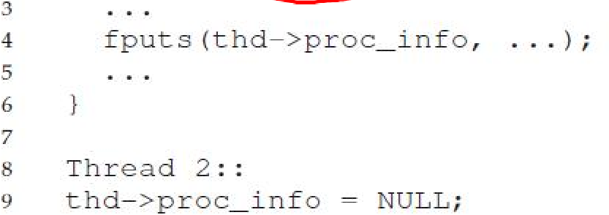
Atomicity bug: example
One thread reads and prints a shared data item, while another concurrently modifies it
Atomicity bugs can occur, not just when writing to shared data, but even when reading it

Slide 5
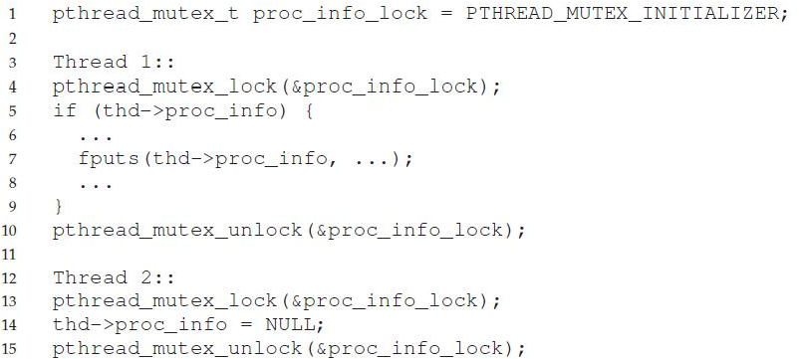
Atomicity bug example: fix
Always use locks when accessing shared data

Slide 6
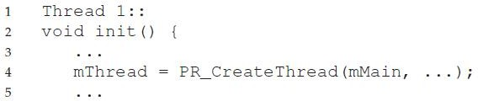
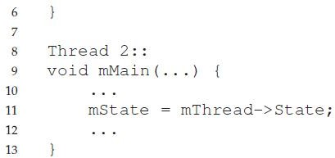
Order violation bug: example
Thread1 assumes Thread2 has already run
No assumptions can be made on order of execution of concurrent threads

Slide 7
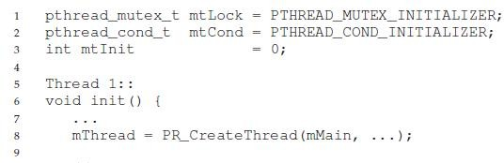
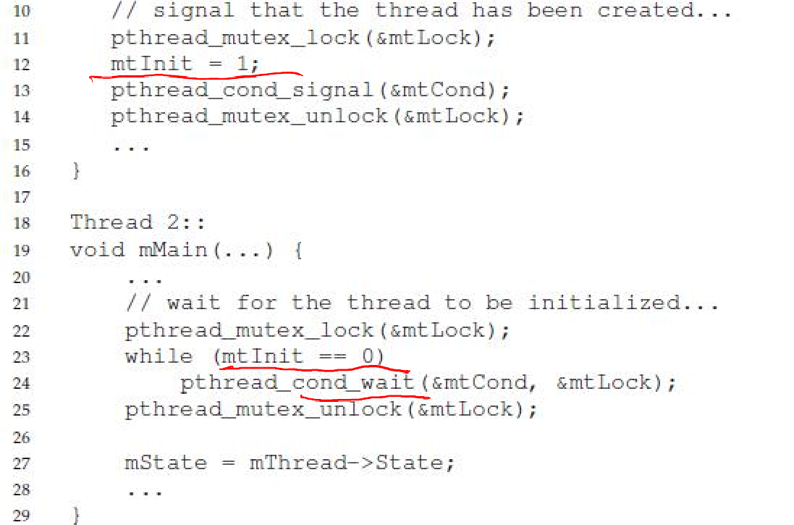
Ordering violation bug example: fix
Use condition variables or semaphores

Slide 8
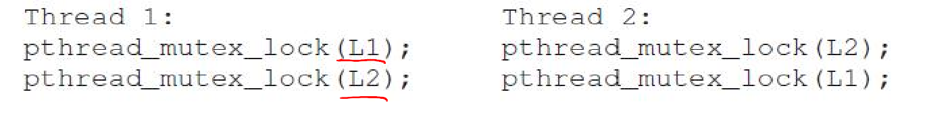
Deadlock bugs
Classic example: Thread1 holds lock L1 and is waiting for lock L2. Thread2 holds L2 and is waiting for L1.
Deadlock need not always occur. Only occurs if executions overlap and context switch from a thread after acquiring only one lock.

Slide 9
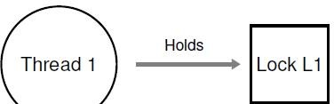
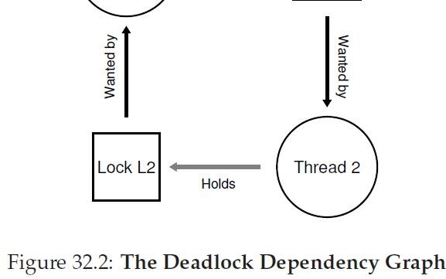
Deadlock: a visual representation
Cycle in a dependency graph

Slide 10
Conditions for deadlock
Mutual exclusion: a thread claims exclusive control of a resource (e.g., lock)
Hold-and-wait: thread holds a resource and is waiting for another
No preemption: thread cannot be made to give up its resource (e.g., cannot take back a lock)
Circular wait: there exists a cycle in the resource dependency graph
ALL four of the above conditions must hold for a deadlock to occur

Slide 11
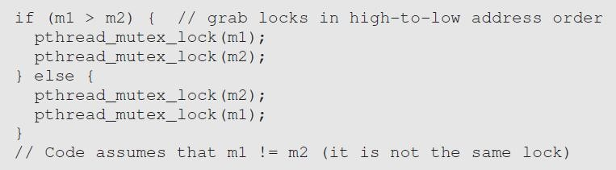
Preventing circular wait
Acquire locks in a certain fixed order
  E.g., both threads acquire L1 before L2
Total ordering (or even a partial ordering on related locks) must be followed
  E.g., order locks by address of lock variable

Slide 12
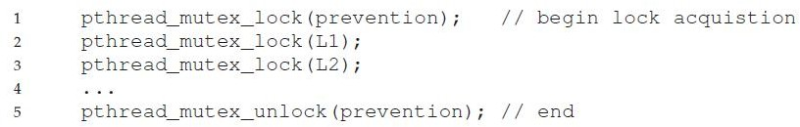
Preventing hold-and-wait
Acquire all locks at once, say, by acquiring a master lock first
But this method may reduce concurrent execution and performance gains

Slide 13


Other solutions to deadlocks
Deadlock avoidance: if OS knew which process needs which locks, it can schedule the processes in that deadlock will not occur
  Banker’s algorithm is very popular, but impractical in real life to assume this knowledge
  Example, below are locks needed by threads and a possible schedule decided by OS
Detect and recover: reboot system or kill deadlocked processes
13

